Slide 1
Face Recognition Algorithm Based on VGG Network Model and SVM
Đào Việt Duy – MSSV:
Nguyễn Duy Hàn Lâm – MSHV: 196005004

Slide 2
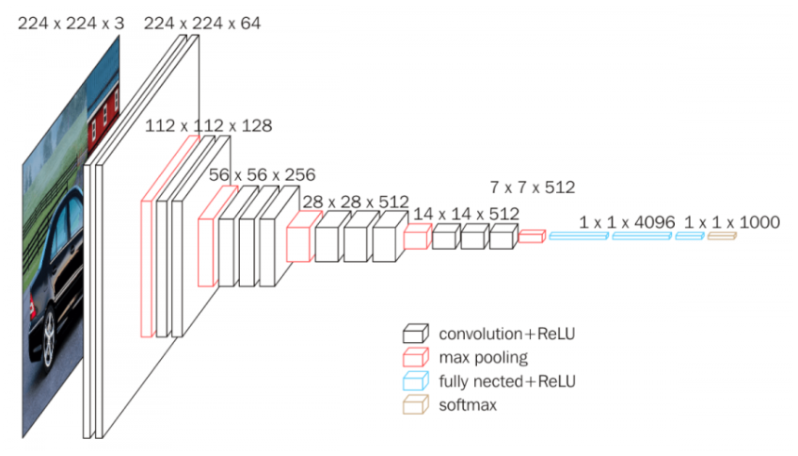
VGG16 model concept

